Slide 1
Housing Price Prediction
Helping to find the right Property

Slide 2
Problem Statement And Understanding
A US-based housing company named Surprise Housing has decided to enter the Australian market.
The company uses data analytics to purchase houses at a price below their actual values and flip them at a higher price.
The company has collected a data set from the sale of houses in Australia in order to analyze and predict the sale prices.
The company is looking at prospective properties to buy houses to enter the market

Slide 3
Exploratory Data Analysis
This is a regression problem. The target variable contains numeric integers in a large scale.
Variable Data-types:
There are integer, float and objects types.
Null Values: There are Null values in the dataset.
Shape: There are 1460 records and 80 features + 1 target variable in the train data. There are 202 records and 80 features in the test data.
The dataset has both numerical and categorical features.

Slide 4
Exploratory Data Analysis Cont.
Descriptive Statistics:
There are some outliers in the dataset.
All the numerical variables are moderately skewed. The means of the variables are larger than their medians.
The numerical variables are in different scales.
Some of the variables have high standard deviation.
There are some extreme outliers in the data based on the max values and the values in the 1st, 2nd and 3rd Quartiles.
Extensive Data cleaning was performed on majority of the variables.

Slide 5
Visualizations

Slide 6
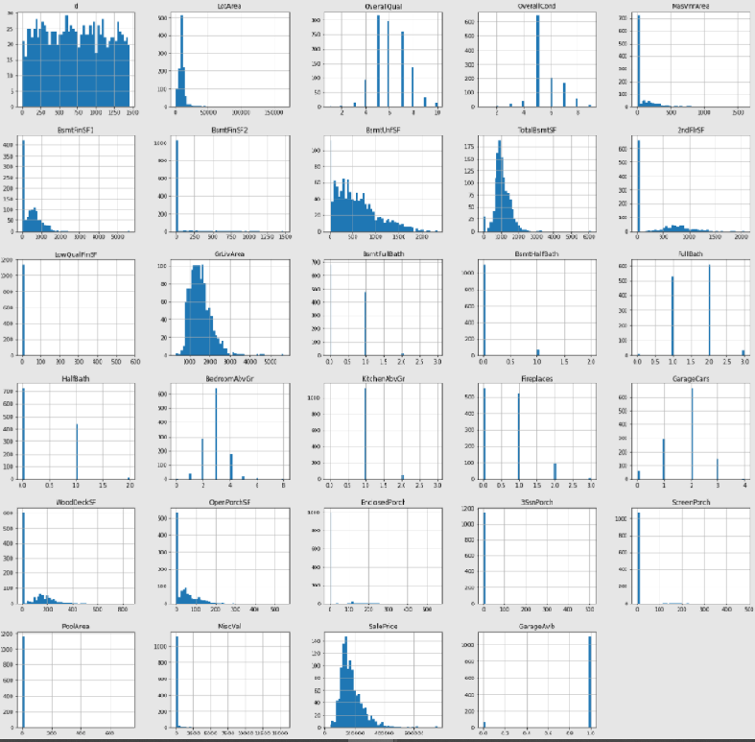
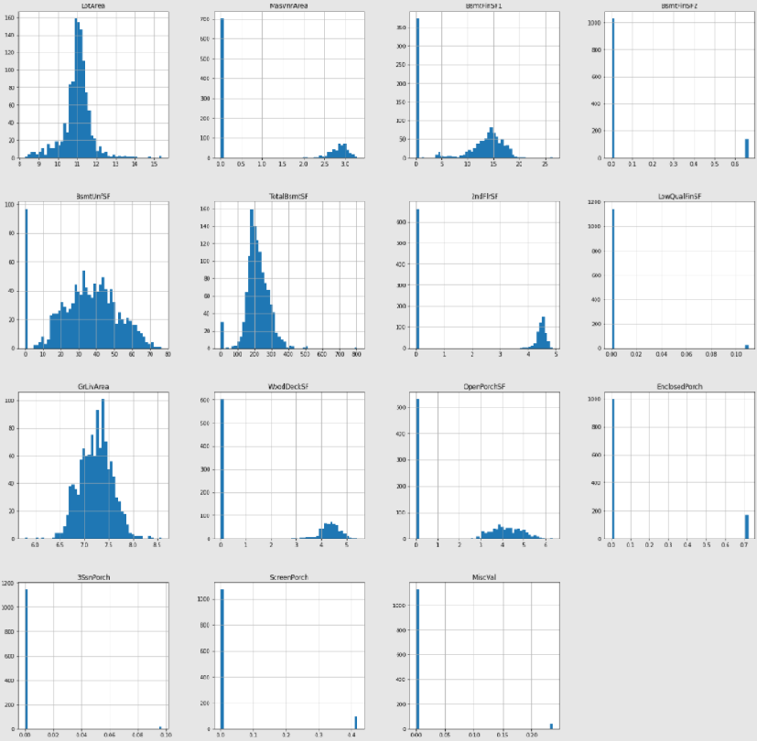
Distribution of the Variables before(left) and after(right) cleaning

Slide 7
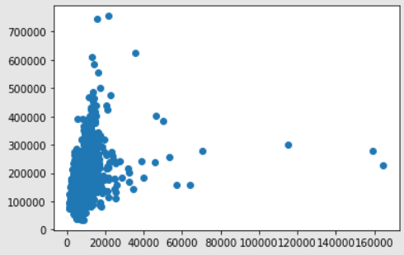
LotArea vs SalePrice
LotArea and SalePrice are positively correlated.
There are some outliers.

Slide 8
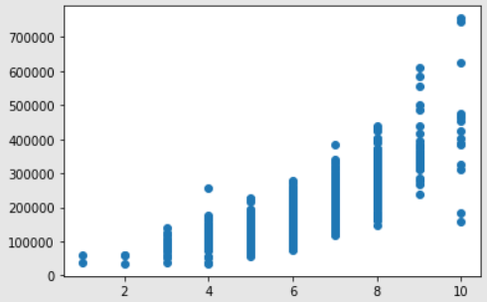
OverallQual vs SalePrice
There is a very good positive correlation between the OverallQual and SalePrice.

Slide 9
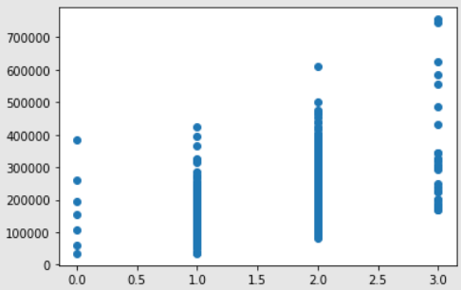
FullBath vs SalePrice
FullBath also has a positive correlation with SalePrice.

Slide 10
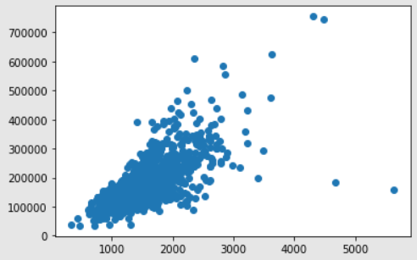
GrLivArea vs SalePrice
The GrLivArea feature is showing a very good positive correlation with the SalePrice.

Slide 11
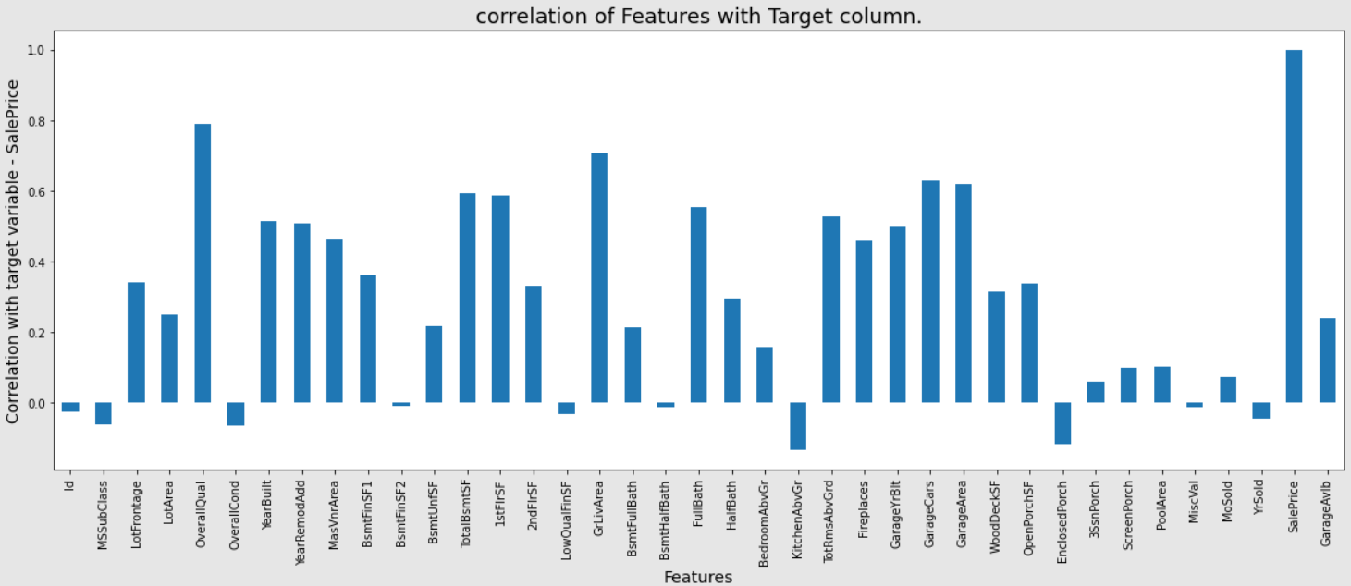
Correlation of Features with Target variable
The OverallQual, GrLivArea, GarageCars, GarageArea, TotalBsmtSF, 1stFlrSF, FullBath are some of the highly correlated features with the target variable.

Slide 12
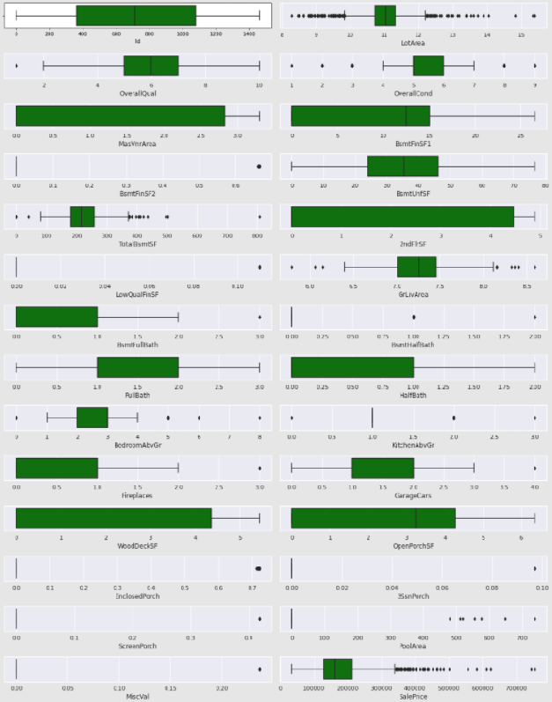
Outliers
As per Z-Score method, the Total percentage of outliers in the data is 33%.
Since there is a large percentage of data as outliers, these outliers could be natural outliers.

Slide 13
Assumptions Made for Data Cleaning activities
Id is a unique identifier for each house. Hence dropped it.
The YearBuilt, YearRemodAdd, GarageYrBlt, YrSold, MoSold are all year and month data. But these are considered as categorical data while solving.
The missing values in some of the categorical features were because the house did not have that feature.
The Large numerical outlier values could be natural variations in the data.

Slide 14
Steps taken to complete the Project
Performed data cleaning based on the information provided and assumptions made.
Performed MinMaxScaler based scaling transformation.
Performed Yeo Johnson based transformation using ‘PowerTransformer’ to remove the skewness in the data.
Trained and validated different Machine Learning classification models(base and ensemble models) to select a suitable model.
Chose the final model based on R2 score and Mean Squared Error metrics.

Slide 15
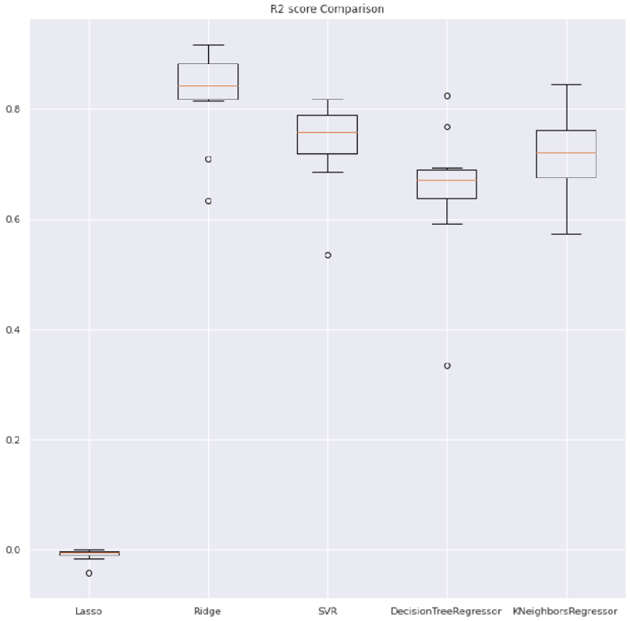
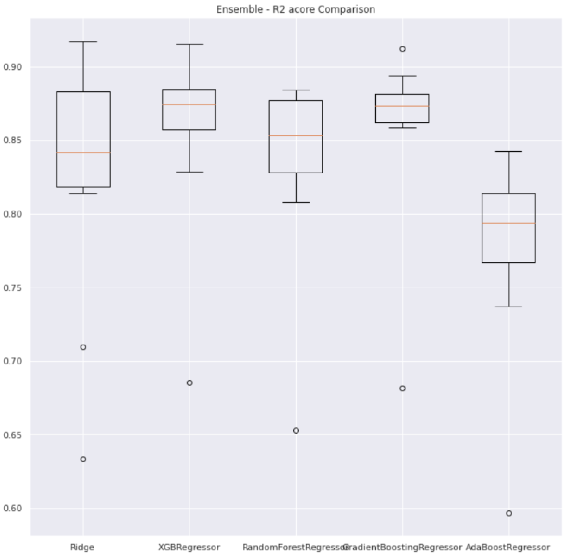
Model score comparison
Simple Models(left) and Ensemble models(right)

Slide 16
Finalized Model
The final model used is XGBRegressor
The tuned hyper parameters used are:
objective = 'reg:squarederror’,
max_depth=2,
learning_rate=0.1,
max_features = 'auto’,
n_estimators=270
The crossval score of the final model with the whole train data is: 0.883 and the Variance is: 0.00073
R2 score of whole Train data: 0.95
Mean Square Error of whole Train data: 0.00079

Slide 17
Conclusion
The XGBRegressor is giving slightly a better result than Ridge and GradientBoostingRegressor. The R2 score and MSE of XGB is better than the other models.
The performance shows low bias and low variance.
The OverallQual, Fireplaces, GrLivArea, TotalBsmtSF, GarageCars, FullBath, OverallCond, BsmtFinSF1, LotArea, BsmtFullBath are the most influential Features to predict the target variable SalePrice.

